Slide 1






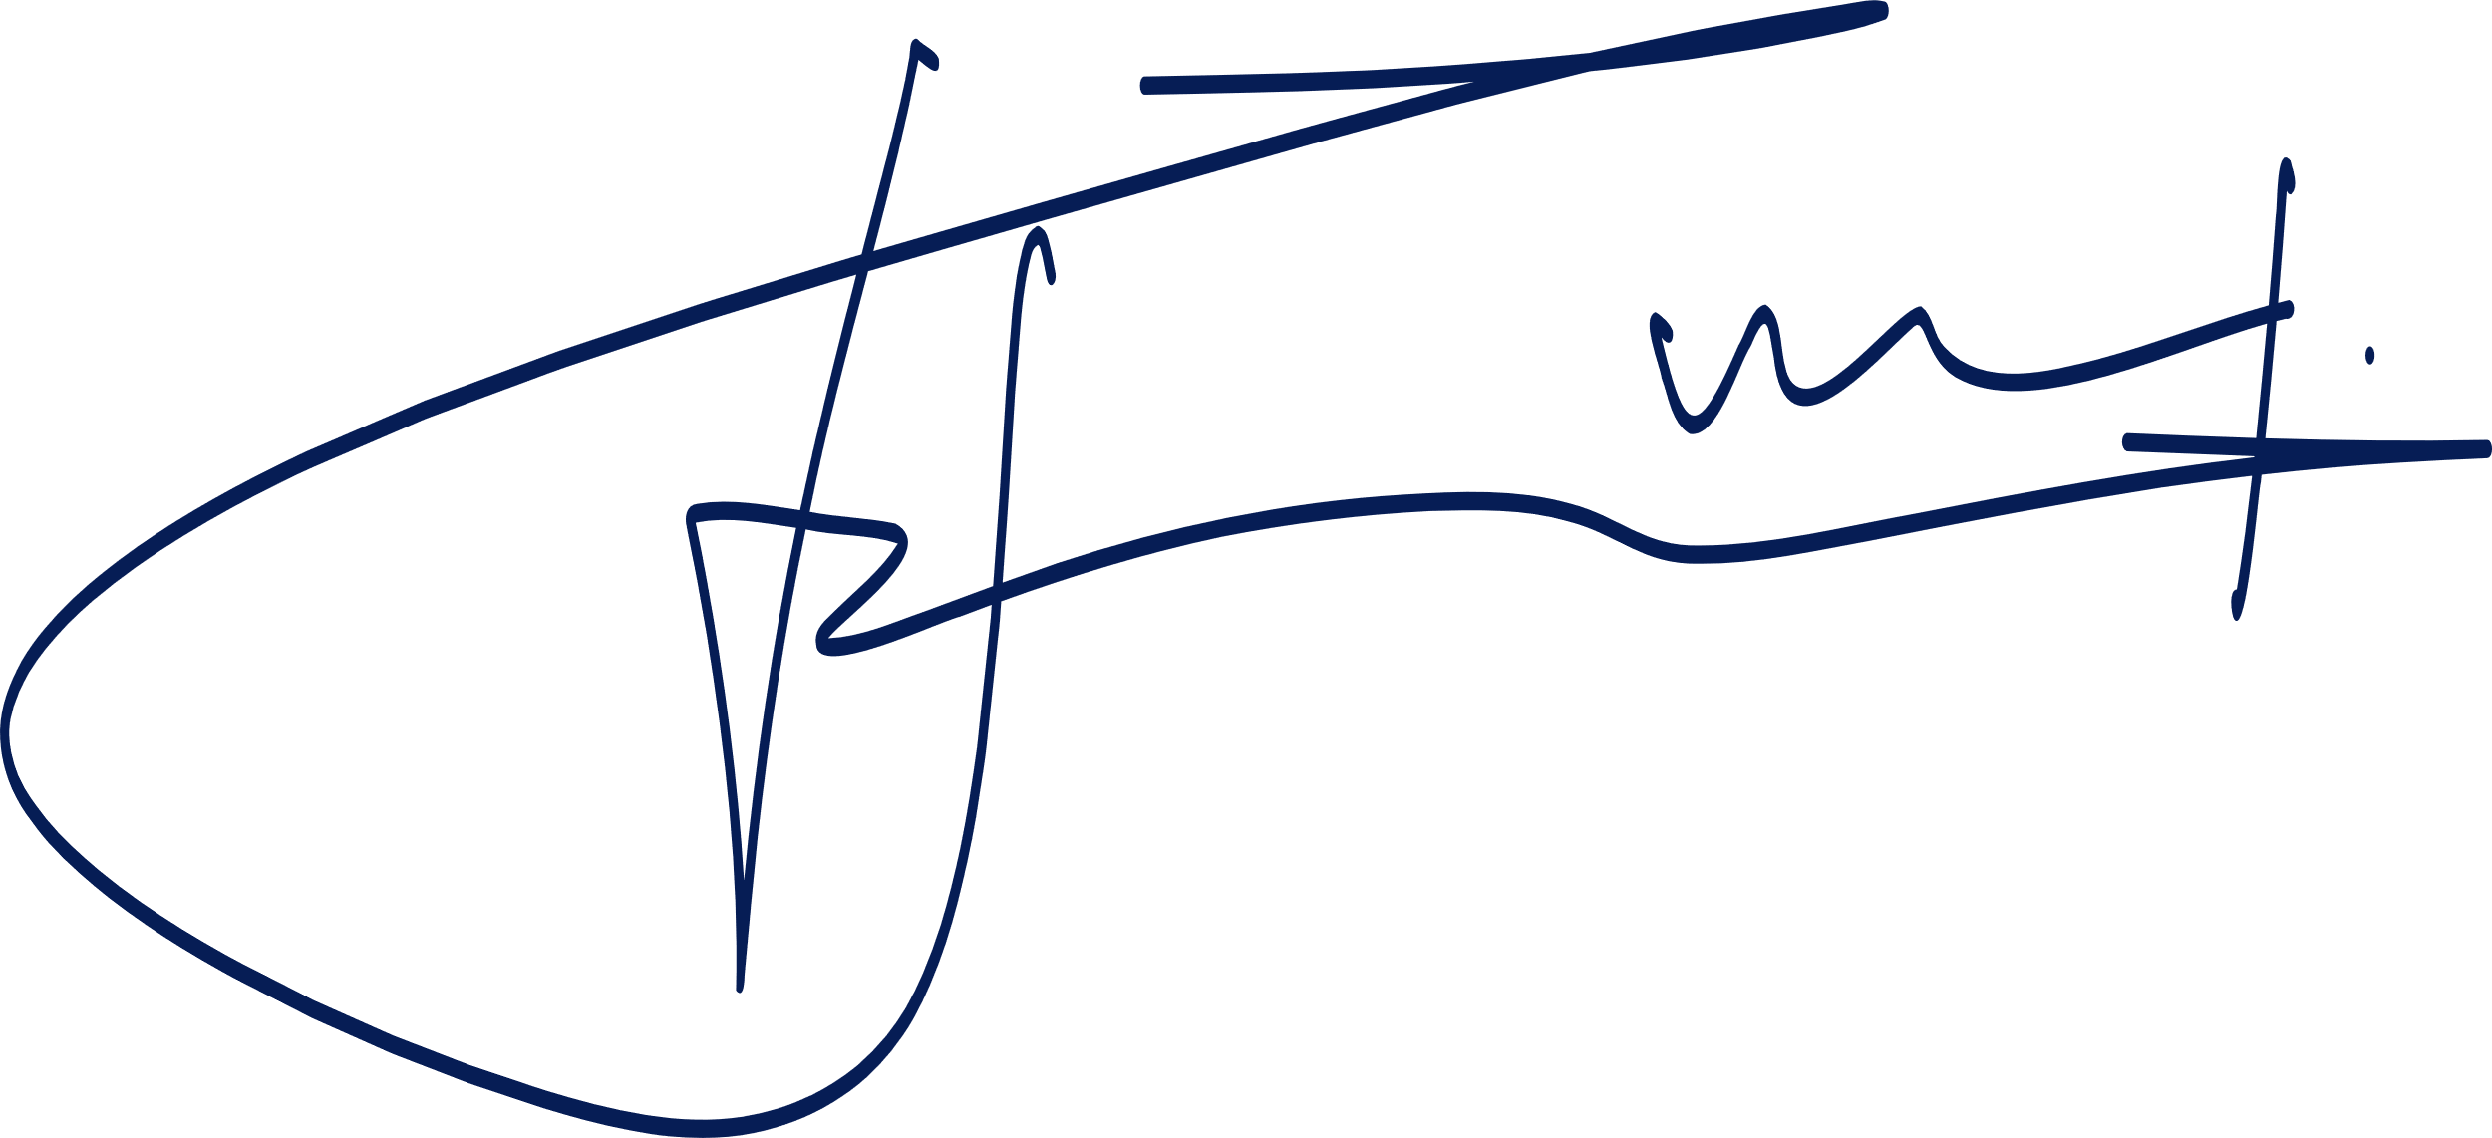

CERTIFICATE
Of Appreciation
This certificate is proudly presented to:
CHAMROEUN SONG
This certificate is given to Marilyn Anastasia for her achievement in the field of education and proves that she is competent in her field.
OLIVIA WILSON
DANIEL GALLEGO
Head Master
Mentor

